Slide 1
Making a PCB with Altium - Memory Guide
Taught by a mechanical engineer

Slide 2
General Points
The aim of this is to act as a memory guide, to jog your memory as to the relevant steps to carry out and buttons to press.
It is not our intention to let you bang your head against a wall for days.
If you have questions, just ask.
If you’re unsure, just give it a go - then show us, and we can help improve it.
Making mistakes and asking for help is how you’ll learn.

Slide 3
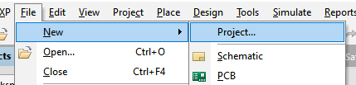
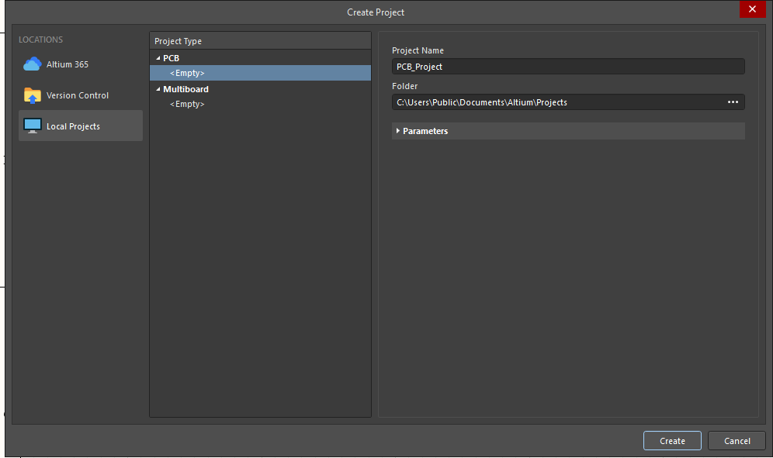
Create Project

Slide 4
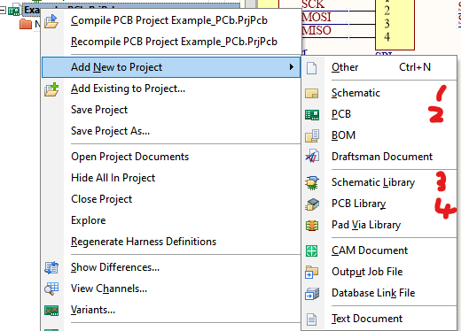
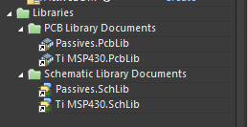
Add Schematic and PCB
Right click project
Add the following “new” to project:
Schematic
PCB
Schematic Library
PCB Library
or
“Add existing”
Select MSP430 and “Passives” libraries

Slide 5
Make a component
Find component on Digikey
Make PCB footprint
Make schematic
Add details
Link component to footprint

Slide 6
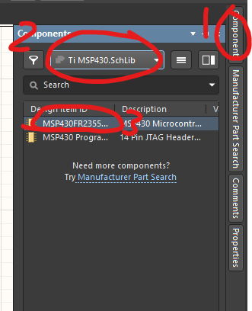
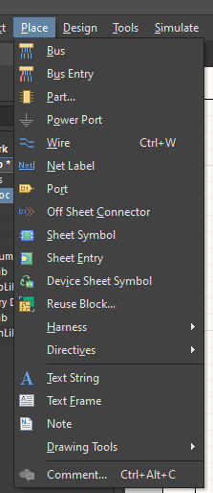
Place components
Find components in the left hand menu
Either from your libraries, or through Altium’s Manufacturer Part Search
Route your wires using wires, net labels, power ports.

Slide 7
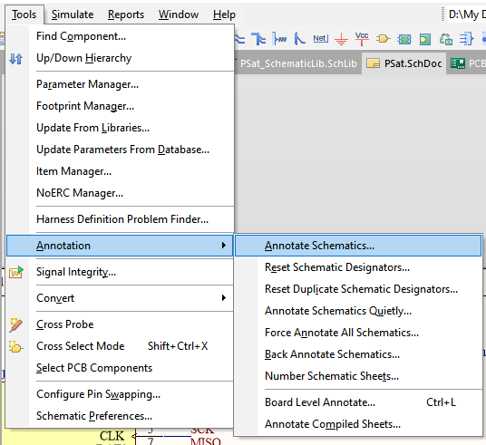
Annotate
Annotate your schematic (give names/numbers to each component)

Slide 8

Add to PCB!

Slide 9
Change PCB Layout
Press “1” to go to layout mode (Design menu)
Edit/create PCB shape
Press “2”
Drag and rearrange your components
“L” to swap between sides of the board
Space to rotate
Press “3” to see your board in 3D

Slide 10

Route tracks to components
Route tracks between your components as necessary
Use “vias” if you need to go between layers
Typically leave Ground until last, and do a polygon pour/plane

Slide 11
Check Rules
Tools->Design Rule Check
(may have to get/import rules from PCBWay)

Slide 12
Add keepout layer

Slide 13
Create outjob

Slide 14
Create BoM

Slide 15
Upload to PCBWay

